Slide 1

Jira Software
Get Started with Jira Software
Notes:
Jira helps you schedule and record work, manage project pipelines, report and fix bugs, triage issues, report time and monitor progress, track changes and tasks, and keep an authoritative, historical, and legal record.

Slide 2

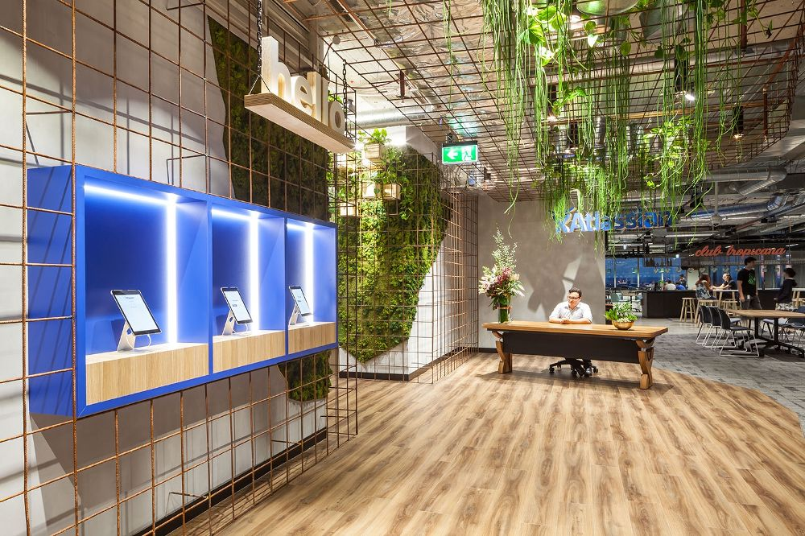
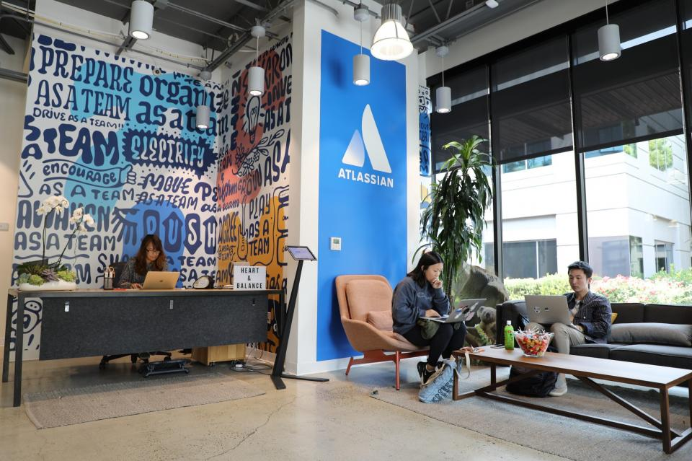

Atlassian Offices
Sydney (HQ)
San Francisco
Mountain View
New York City
Manila
Sydney
Bengaluru
Austin
Amsterdam
Yokohama
Boston
Ankara
Notes:
How they look? Are they cool?
Atlassian is an Australian enterprise software giant that develops products for software development, project management and content management. It is founded in 2002. Now Atlassian $40 billion valued company.
It is best known for the issue tracking applications. The company's flagship product is JIRA . JIRA is the primary product of Atlassion- It is a project management and bug tracking tool used by thousands of companies and organisations including NASA and Tesla.
Atlassian serves more than 180,000 customers. It has approximately 5000 employees.
It has offices in 7 countries. It headquarter in Sydney.
They say there are 2 planets they have software on. What does it mean ? It was used in NASA's Mars program. Curiosity etc.

Slide 3

Did you finish the Jira Software (Get Started with Jira) pre-class activity?
Notes:
🍐 This is a Pear Deck Multiple Choice Slide. Your current options are: A: I finished completely., B: I finished partially., C: No, I didn't finish.,
🍐 To edit the type of question or choices, go back to the "Ask Students a Question" in the Pear Deck sidebar.
Did you finish the preclass activity?
Jira class is not very hard.
Many companies use jira . İt is like tirello,

Slide 4
Table of Contents
Introduction to Jira
Jira Products
Jira Software Hosting Options
Setting up Jira Software Cloud
Navigating in Jira
Jira Concepts
Jira Integrations
Notes:
This is the table of topics
In this class, I'll introduce you to Jira. You'll get to know the different Jira products and hosting options. We will talk about setting Jira Software Cloud.
You'll meet some typical Jira users and find out how they use it.
You'll also get to know what determines what you can do in Jira.
Finally we'll show you how to get around in Jira.
Popüler issue tracking yazılımı JIRA'nın üreticisi Atlassian, agile değerlerini ürünlerinde uygulamaya koymaktadır. JIRA ile çıkarak Agile yazılım geliştirmede lider olmuştur. JIRA iki agile metodolojiyi destekler:
Scrum yazılım geliştirme için en uygunu iken Kanban daha çok iş ve operasyon takımları için uygundur.

Slide 5
Introduction to Jira
1

Slide 6
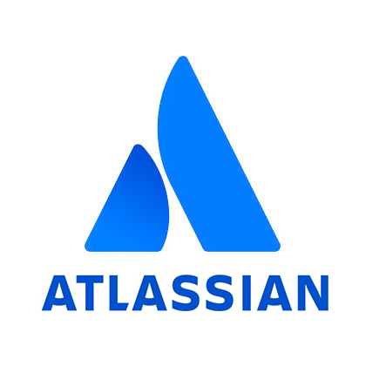


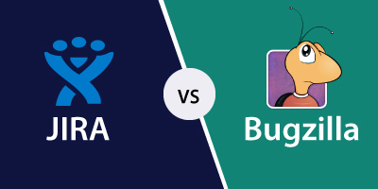

What is Jira?
Project Management
Issue Tracking
Bug Tracking
Notes:
What is jira ?
Jira is a tool developed to assist teams in project management,
software bug tracking, and issue tracking.
In simple terms, it is an issue tracker.
Jira is widely used by large companies in software development and software testing.
It is a web-based and licensed product created by the Australian company Atlassian.
Is there anyone who know where the name jira comes? What jira means?
The name "Jira" is derived from the abbreviation of Gojira,
which is Japanese for Godzilla. It refers to the rival Bugzilla.

Slide 7


What is Jira?
A tool used to help teams perform, visualize and manage work.
Models the team’s current processes/workflows.
You can open tickets or issues and push them through various statuses in your processes
Notes:
When Jira was launched in 2002, it was seen as an issue tracking software used by software developers.
Later, this application was accepted as a project management tool by software companies and also other organizations.
You can create your business-based processes into digital boards and open tickets or issues. You can drag the issues create your own workflows in Jira.
And by dragging and dropping these issues through various situations in your processes, you can enter relevant information throughout the process. Into tickets, into issues.
As they are used in agile project management you can think that jira is a tool for scrum and kanban,
but you can also use it in any company and in any project.

Slide 8



Why Jira?
Leverage project management technology, allowing teams to focus on their work.
Facilitates planning, prioritizing, organizing and completing work.
Visualizes work using project boards, reports and dashboards.
Facilitates team communication.
Notes:
as a Leverage for project management technology, it allows teams to focus on their work.
Makes it easy in planning, organizing and completing work.
Using project boards, reports and dashboards, it makes everything visual
Facilitates team communication.
As a summery
You can;
Schedule and record work,
manage project pipelines,
report and fix bugs,
ordering issues -
report time and monitor progress,
track changes and tasks, and
keep an authoritative, historical, and legal record.

Slide 9
Who Uses Jira?
Jira Software launched in 2002 as an issue tracking and project management tool for teams.
65K+
More than 65,000 companies around the world rely on Jira Software to manage their projects.
Teams of 2 through 2000
Jira is used by teams of 2 - 2000 people in companies of all sizes.
Notes:
And who uses jira
We will talk about the teams and companies that use Jira.
maybe software teams can use it in general but also a whole company can use it if it is suitable for their use.
Jira Software was released in 2002 as an issue tracking and project management tool for teams.
Since then, more than 65,000 companies worldwide have used and adopted Jira.
Why, It works with the flexibility to support all kinds of projects and thousands of applications and integrations.
More than 65,000 companies around the world use Jira Software to manage their projects.
Jira is used by teams of 2 and 2000 people in companies of all sizes.

Slide 10






Who Uses Jira?
financial services
retail
software
high-tech
automotive
government
non-profit organizations
Notes:
Jira Software is a tool that can help teams in financial services, retail, software,
high-tech, automotive, non-profit organizations, government, life sciences and many more industries.
These organizations work productively as organized.
If your team has a project to complete, you can use Jira Software to manage it.
The beauty of Jira Software is that it can be configured to suit any project,
from simple task management to highly complex ventures/enterprises.

Slide 11








Who Uses Jira?
financial services
retail
software
high-tech
automotive
government
non-profit organizations
Notes:
lets talk about which companies use Jira.
CARFAX is a virginia-based company. It provides vehicle history reports for used cars and trucks for American and Canadian consumers.
Autodesk is a US company that develops professional software for industrial use. It contains the most used industrial software in the world. Autodesk is also known for being one of the top software code generators. The most used software is Autocad.
Is there any grafic designer here? Who used autocad. It is a tool for grafic design. It is a very big company.
Cancer Research UK conducts research as the world's largest independent cancer research charity.
Audi is a German automobile manufacturer that designs and manufactures luxury vehicles. It is based in Bavaria.
The Telegraph is a national British daily newspaper publication published in London and distributed in the UK and internationally.
ANZ is the largest New Zealand bank headquartered in Auckland New Zealand.
Blend is a financial services firm located in San Francisco.
Domino's Pizza is an international pizza delivery company headquartered in Michigan, USA.

Slide 12
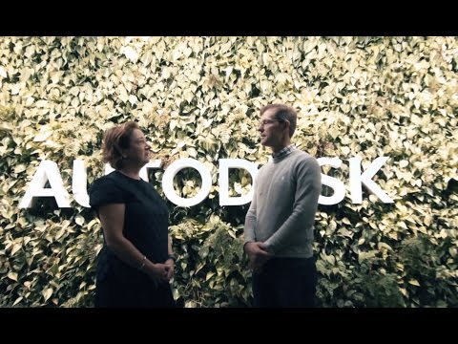
JIRA Customer Story
Notes:
First lets watch the audi video.
Since the introduction of AutoCAD in 1982, Autodesk has been a leader in 3D design, engineering and entertainment software. Today, Autodesk's product portfolio includes more than 100 products available in 18 different languages.
Autodesk has over 100 engineering teams, and each group has a unique process for software development and delivery. “It is very difficult to maintain consistent documentation and an efficient process flow across many teams,” explains Peter Jones, senior manager of operational excellence at Autodesk. He states that they overcame this with Jira.

Slide 13


Jira is only used by software development teams.
Notes:
🍐 This is a Pear Deck Multiple Choice Slide. Your current options are: A: True, B: False,
🍐 To edit the type of question or choices, go back to the "Ask Students a Question" in the Pear Deck sidebar.
Here is peardeck question?
false, right?
software developers use ok but business people also use it.

Slide 14

Have you ever used Jira before?
Has your company used Jira products?
Notes:
Summarize
Have students write a quick, 1-2 sentence summary of the information they’ve just learned.
🍐 This is a Pear Deck Text Slide
🍐 To edit the type of question, go back to the "Ask Students a Question" in the Pear Deck sidebar.
Lets check your answers

Slide 15
Jira Products
2

Slide 16















Atlassian Products
PLAN, TRACK, & SUPPORT
COLLABORATE
CODE, BUILD, & SHIP
SECURITY & IDENTITY
Notes:
Now we will talk about jira products.
Atlassian has many products. You can see them in atlassian web site products page.
PLAN, TRACK and SUPPORT products:
(yansıdan)
Do you know OpsGenie? OpsGenie is essentially a problem management tool
that receives alerts from your monitoring systems and custom applications and
categorizes each alert according to importance and timing. It was developed in Ankara.Turkey
It is Founded in 2012, and OpsGenie In 2019 was purchased by Atlassian for nearly $ 300M
As you see in software business the amount of money we talk about is million to billion dollars.
Any way lets come to our topic again:
COOPERATION TOOLS
Confluence is a content collaboration tool developed for teams.
In Confluence, content is created using spaces, pages and blogs.
Trello is a web based project management application.
It was bought by Atlassian company for 425 million dollars in 2017.
SECURITY AND IDENTITY,
Crowd, is an application security framework that provides authentication and authorization for your web-based applications.
Atlassian Access ,is an enterprise-grade security and centralized management tool in all Atlassian cloud products.
CODE AND VERSION MANAGEMENT
Bitbucket is a web-based version control repository hosting service.
Sourcetree is a powerful Git desktop client for developers using Mac or Windows.
Bamboo is a continuous integration and continuous distribution server
Fisheye is a revision control browser and search engine
Crucible is a collaborative code review application.

Slide 17



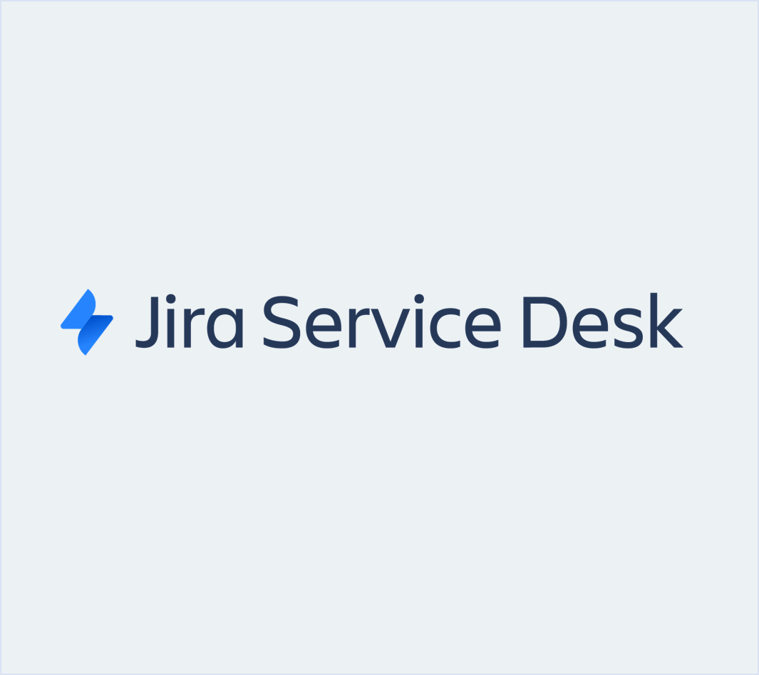


Jira Family
Agile Teams
Software developers
Large organizations
Business users
Service desk agents
Jira Software
Notes:
Lets dive deep deep these products
Jira is built for teams to manage their projects and track their work.
It's offered in four different products - Jira Software, Jira Allign, Jira Service Desk, and Jira Core.
You may have two of these products at your site, just one, or all of them,
depending on the type of teams you have and what you're looking to accomplish.
Jira Software is used by software development teams to plan, track, and release software.
Jira Service Desk is used by IT and Customer Service teams to create and run their service desks.
Jira Core is used by business teams such as Finance, Marketing, and HR to manage projects and keep their teams organized.
These are the typical use cases for the three Jira products but only your imagination is the limit!
Jira, takımların projelerini yönetmeleri ve çalışmalarını takip etmeleri için tasarlandı. Dört farklı üründe sunulmaktadır: Jira Software, Jira Servis Masası, Jira Align ve Jira Core. Sahip olduğunuz takımların türüne ve neyi başarmak istediğinize bağlı olarak, şirketinizde bu ürünlerden birine ikisine ya da hepsine sahip olup yönetebilirsiniz.
Jira Software, yazılım geliştirme ekipleri tarafından yazılımı planlamak, izlemek ve yayınlamak için kullanılır.
Jira Service Desk, BT ve Müşteri Hizmetleri ekipleri tarafından servis masalarını oluşturmak ve çalıştırmak için kullanılır.
Jira Core, projeleri yönetmek ve takımları organize tutmak için Finans, Pazarlama ve İK gibi iş takımları tarafından kullanılır.
Bunlar dört Jira ürünü için tipik kullanım durumlarıdır, ancak sadece hayal gücünüz sınırdır!
Agile takımları ise Jira Software kullanır.

Slide 18
Jira Family
Product | Description
Jira Software | This is a software development tool used by agile teams (formerly known as JIRA Agile). It is very suitable for software development teams who want to use agile methodologies such as Scrum and Kanban.
Jira Align | Jira Align is a member of the Jira family which allows the company leadership to monitor current developments and link them to business outcomes at an enterprise scale.
Jira Core | This is similar to the classic Jira, optimized for business teams, with all the field customizations and workflow capabilities. Jira Core keeps the teams organized by managing projects, monitoring details, and measuring performance.
Jira Service Desk | Jira Service Desk is a modern IT service desk software that can run on the cloud or server. With this product, service desks can easily receive, monitor, manage and resolve the requests from customers.
Notes:
Jira Software is used to fix bugs, create sprints and monitor build statuses.
Jira Service Desk is used to log service tickets, monitor service queues and resolve service requests.
Jira Core is used to create and monitor business tasks.
Lets look them from Atlassian website

Slide 19

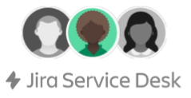

What You Can Do in Jira?
It depends on what role you have in your organization
Scrum Master
IT Manager
HR Manager
Creates and manages sprints
Creates SLAs and request types
Creates reports
Notes:
The whole software development team has access to Jira Software to manage their software projects but only scrum masters can create and manage sprints.
And Support teams have access to Jira Service Desk to run their help desks but only IT Managers can create (SLA) Service Level Agreements and request types.
Service level agreement = A service-level agreement (SLA) is a commitment between a service provider and a client.
Particular aspects of the service –
quality, availability, responsibilities –
are agreed between the service provider and the service user.
And Business Teams use Jira Core to manage their tasks but only managers can create reports.

Slide 20

Select the right Jira Product for the following use case.
Helping cable customers with a Help Desk
Notes:
🍐 This is a Pear Deck Multiple Choice Slide. Your current options are: A: Jira Software, B: Jira Service Desk, C: Jira Core,
🍐 To edit the type of question or choices, go back to the "Ask Students a Question" in the Pear Deck sidebar.
Select the right Jira Product for the following use case.

Slide 21

Select the right Jira Product for the following use case.
Creating a Rental Car app
Notes:
🍐 This is a Pear Deck Multiple Choice Slide. Your current options are: A: Jira Software, B: Jira Service Desk, C: Jira Core,
🍐 To edit the type of question or choices, go back to the "Ask Students a Question" in the Pear Deck sidebar.
Select the right Jira Product for the following use case.

Slide 22
Jira Software Hosting Options
3
Notes:
Jira Software Barındırma Seçenekleri

Slide 23
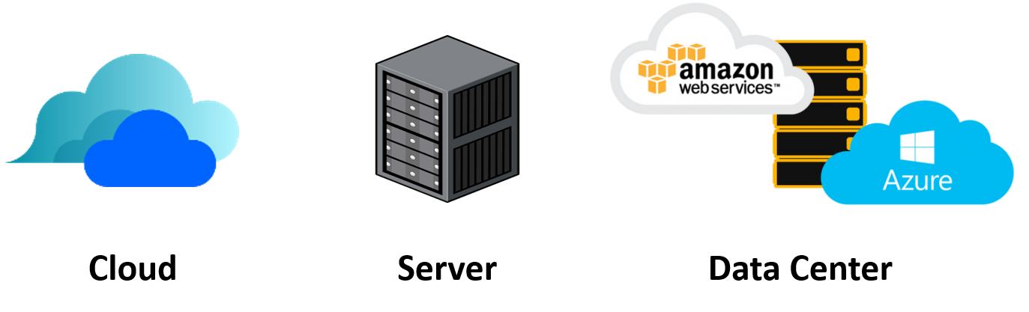
Hosting Options
Self-managed Options
Notes:
Jira Software is basically offered to you in two hosting options:
cloud and self-management.
For the self-management option, customers can choose between server and data center.
It is necessary to examine these options to decide which option is the most suitable.
Jira Software esasında size iki barındırma seçeneğiyle sunulur: bulut ve kendi kendini yönetme. Kendi kendini yönetme seçeneği için müşteriler sunucu ve veri merkezi arasında seçim yapabilir. Hangi seçeneğin en uygun olduğuna karar vermek için bu seçenekleri incelemek lazım.

Slide 24

Atlassian Cloud
Fast start-up
Reduced costs
With Jira Software Cloud, the Jira Software site is hosted and installed in the cloud for you.
This hosting option is usually preferred by the teams who want to get started quickly and practically.
Thus, agile teams are free from managing the technical complexity of the hosting process.
No need to upgrade
Work on the go
Security
Scale with confidence
Notes:
With Jira Software Cloud, the Jira Software site is hosted and installed in the cloud for you. This is often the best option for teams that want to get started quickly and easily, and for teams that don't want to manage the technical complexity of hosting.
Thus, agile teams avoid managing the technical complexity of the hosting process.
quick launch --- As soon as you sign up, you can start working and inviting team members.
low cost --- You save on physical hardware, maintenance, installation and support, and other management costs.
no need to upgrade --- you get instant access to the latest and greatest features, no work required.
Working on the go --- Cloud products allow teams to take their work anywhere and can be safely accessed from any browser or our cloud mobile apps.
security ---- We help your organization stay secure and compliant with real-time security updates and rigorous practices to monitor and protect your information.
Scale with confidence --- We handle inventory and storage provisioning in the cloud. Respond immediately to dynamic increases in demand and team growth.

Slide 25

Server
Want advanced control
Need data locality
Have experience with self-hosted applications
Jira Software Server allows you to host Jira Software on your own hardware and customize it to suit your needs when installing.
This is often the best option for teams that have experience with self-hosted applications and need to manage all the details.
Notes:
With self-hosted products, you install, host and run the products on your own hardware. You can customize your setup as you wish.
Want enhanced control: Teams that want to manage all the details can be what the resilience server offers
If it is necessary to keep data locally: Companies with data hosting and localization requirements can choose the server.
Teams with experience with self-hosted applications: Teams that can take the complexity out of installing and hosting applications on their own servers and make sure that they secure and protect them over time can choose the server.

Slide 26
Data Center
Maintain uninterrupted access to Jira Software
Scale to meet their organization’s demand
Upgrade with zero downtime for easier administration
With this option, Jira Software can be hosted on your hardware or public cloud services such as Amazon Web Services (AWS) and Microsoft Azure.
Jira Software Data Center is often the best deployment option for enterprise teams that need uninterrupted access and high performance.
Notes:
With this option, Jira Software can be hosted on your hardware or public cloud services such as Amazon Web Services (AWS) and Microsoft Azure.
Jira Software Data Center is often the best deployment option for enterprise teams requiring uninterrupted access and high performance.
Get uninterrupted access to Jira Software
Scaling to meet the demand of their organizations
Zero downtime upgrade for easier management

Slide 27

Which of the following hosting options is appropriate for agile teams who avoid managing the technical complexity of hosting?
Notes:
🍐 This is a Pear Deck Multiple Choice Slide. Your current options are: A: Microsoft Azure, B: Data Center, C: Atlassian Cloud, D: Server,
🍐 To edit the type of question or choices, go back to the "Ask Students a Question" in the Pear Deck sidebar.
Which of the following hosting options is appropriate for agile teams who avoid managing the technical complexity of hosting?

Slide 28
Setting up
Jira Software Cloud
4
Notes:
Now lets have a break and we will continue from here in next lesson.
In the first hour we talked about atlassian and its’ jira tool. What is jira and who uses it.
Now we will see setting up the jira.

Slide 29



Setting up Jira Software Cloud
Go to the Atlassian website.
Select the Jira Software option.
Decide which plan is right for you.
Create your Atlassian account.
Personalize your experience.
Invite your team.
Answer questions to Recommend a Project.
Choose a template.
Create project.
Notes:
here is how to set up your jira coud.
(Up to ten people it is free.)

Slide 30
Have you created your Jira Software Cloud site?
Notes:
🍐 This is a Pear Deck Multiple Choice Slide. Your current options are: A: Yes, B: No,
🍐 To edit the type of question or choices, go back to the "Ask Students a Question" in the Pear Deck sidebar.
Have you created your Jira Software Cloud site?
In jıra classes we will use jira software cloud.

Slide 31
Navigating in Jira
5
Notes:
We can later check this. First lets look at to atlassian web site.
Open Agile page.
talk about agile, scrum,
https://www.atlassian.com/?_ga=2.93469716.825926990.1620640716-1035360331.1620640716

Slide 32
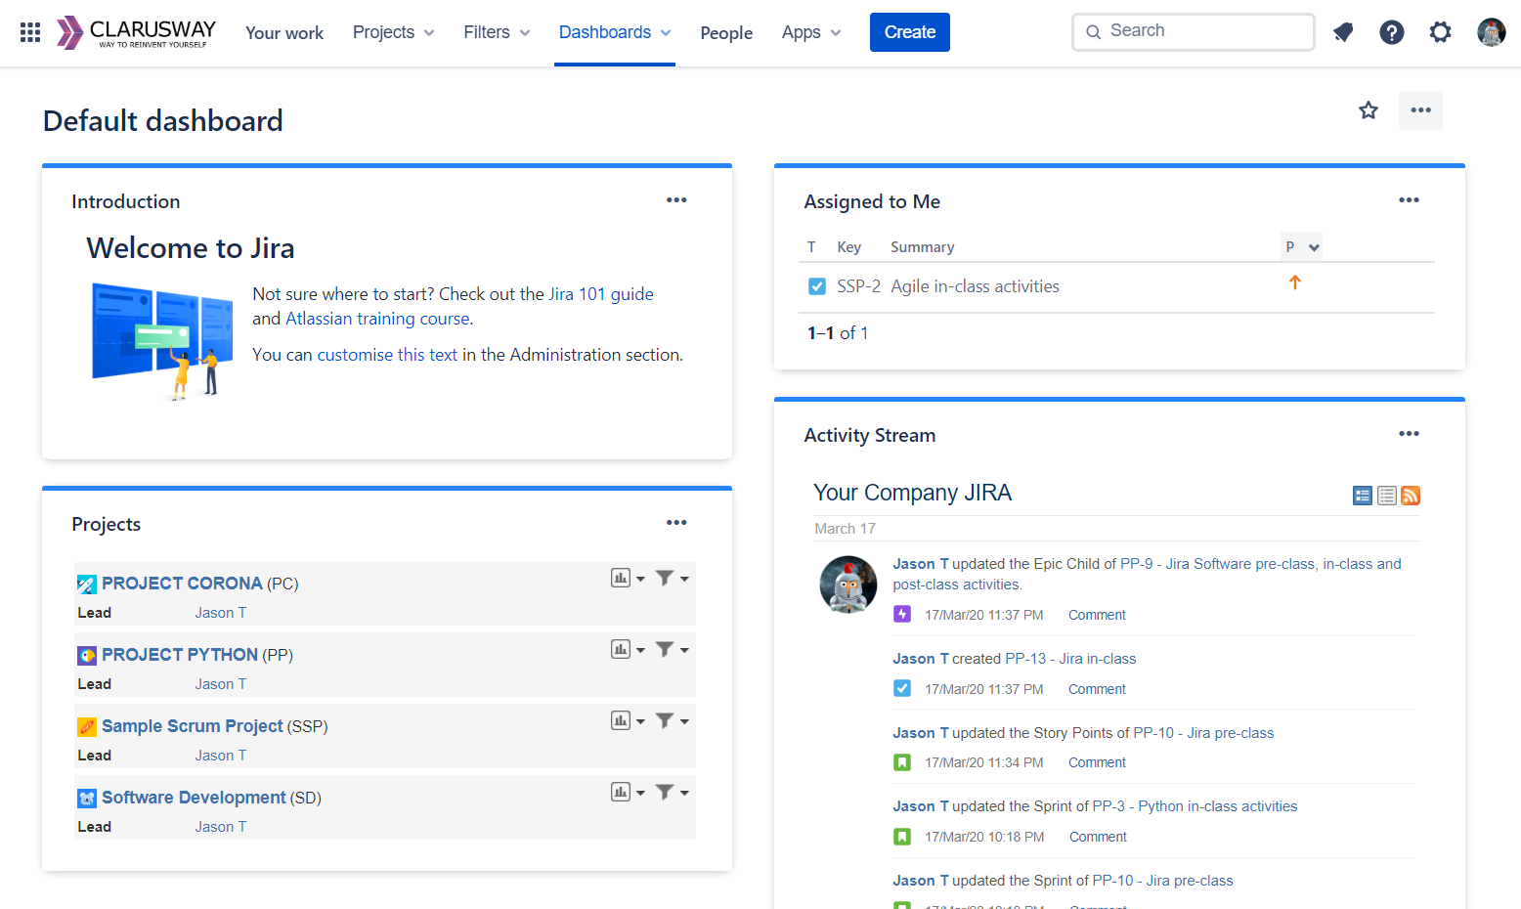
Navigating in Jira
Switch to
Company logo
Your work
Projects
Filters
Dashboards
People
Apps
Notes:
So, what we gonna cover here is navigating in jira. There would be some differences because atlassian is updates its side .
But general issue is the same.
Depending on your permissions and how your Jira is set up, your Jira might look slightly different than that. However, the basics of navigation are the same.
Menus vary depending on which page you are on. System Dashboard you can see when you first log in. Your Jira administrator sets this up with information useful for your users.
Wherever you are in Jira, you will see the global menu where you can access dashboards, view starred and new boards, projects, filters, issues and dashboards. You can search for issues, boards, and filters. You can create issue, view notifications, switch to other Atiassian applications and access your profile.
The first time you log into Jira, you'll see a dashboard like the one pictured.
This is an example of a default system dashboard.
This view helps you see useful data like issues assigned to you and activities that recently occurred.
The example shows that there are many issues assigned to me. I'd better get to work.
Your system dashboard probably looks slightly different.
Again, it's okay if your screens don't look exactly like mine, the concepts are the same, even if the colors, layout and data is different.
Jira remembers the dashboard you accessed last, so you might see a totally different dashboard instead.
You can also create your own custom dashboards. I'll show you how to create and share dashboards later in the course.

Slide 33
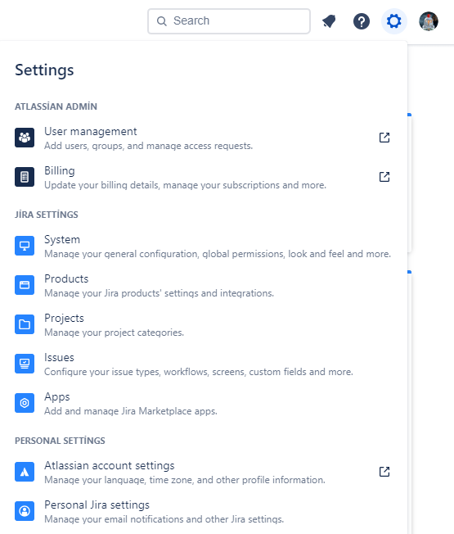
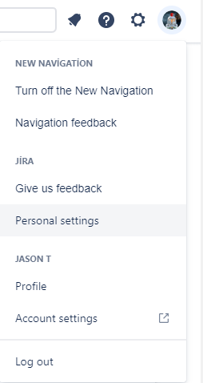
Settings & Profile
User management
Billing
System
Products
Projects
Issues
Apps
Personal Settings
Notes:
What you can view and change from your profile:
Name surname
Nickname
Job name
episode
organization
place
Time Zone

Slide 34
Jira Concepts
6

Slide 35
Jira Structure
Structure your work in Jira
Initiative
from the largest objectives down to the minute details
Epic
Epic
Epic
Story/Task
Story
Task
Story
Task
Subtask
Subtask
Subtask
Subtask
Subtask
Subtask
Notes:
Let's say you work at SpaceX, your team will do something ambitious like launch a rocket into space. To do this, you will need to structure your work from the largest goals to minute details. You will want to report your progress and stick to a plan created. Epics, stories, initiatives will be the tools needed to detail your business.
Initiatives are collections of epics that drive toward a common goal.
Epics are large bodies of work that can be broken down into a number of smaller tasks (called stories).
Stories, also called “user stories,” are short requirements or requests written from the perspective of an end user.
Subtask - Work components that make up the stories.
Themes are large focus areas that span the organization.
Initiatives are collections of epics
Themes are labels that track high-level organizational goals
On an agile team, stories are something the team can commit to finish within a one or two-week sprint. Oftentimes, developers would work on dozens of stories a month. Epics, in contrast, are few in number and take longer to complete. Teams often have two or three epics they work to complete each quarter.
You’ll want to be able to respond to change, report your progress, and stick to a plan. Epics, stories, themes, and initiatives are precisely the tools you’ll need to do so.

Slide 36
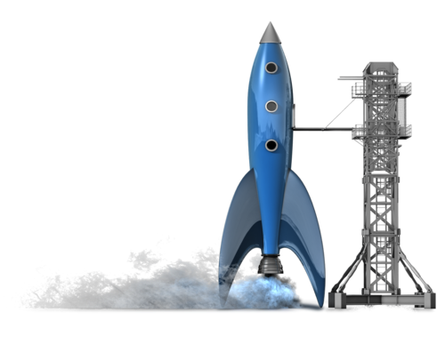
Which one is named as collection of epics that drive toward a common goal?
Notes:
🍐 This is a Pear Deck Multiple Choice Slide. Your current options are: A: Theme, B: Initiative, C: Story, D: Task,
🍐 To edit the type of question or choices, go back to the "Ask Students a Question" in the Pear Deck sidebar.
Which one is named as collection of epics that drive toward a common goal?

Slide 37
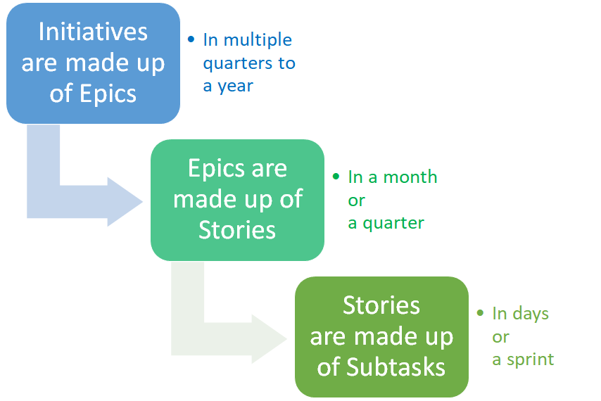
Jira Structure

Slide 38

………. are large bodies of work that can be broken down into a number of smaller stories.
Notes:
🍐 This is a Pear Deck Multiple Choice Slide. Your current options are: A: Epics, B: Stories, C: Tasks, D: Subtasks,
🍐 To edit the type of question or choices, go back to the "Ask Students a Question" in the Pear Deck sidebar.
…...are large bodies of work that can be broken down into a number of smaller stories.

Slide 39




Jira Structure
Initiative
Collections of epics that drive toward a common goal
Epic
Big chunk of work that has one common objective
Story
Short requirements written from the perspective of an end user.
Subtask
Smaller piece of story

Slide 40






Jira User Types
Jira Administrator
Jira Project Administrator
Team Member
Configures the Jira instance for all users
Configures the Jira project to match the team’s process
Works on Jira projects
Notes:
There are 3 main user types in Jira.
A Jira Administrator has the most capability inside of Jira. Jira Admin controls all access to Jira applications and what users can do in Jira.
In general a Jira Project Administrator only has permission to configure specific projects.
Finally, there are team members who are working inside of Jira.
If you are on the Jira Software or Jira Core Cloud Free plan, anyone who can access this site is a project manager. It is not possible to change the permission scheme, edit roles.

Slide 41




Jira User Types
COMPANY
A few Jira Administrator
One or more Project Admin for each project
Many Team Members
Notes:
There are 3 main user types in Jira.
A Jira Administrator has the most capability inside of Jira.
In general a Jira Project Administrator only has permission to configure specific projects.
Finally, there are team members who are working inside of Jira.

Slide 42

Who controls what Jira products you have access to and what you can do in Jira?
Notes:
🍐 This is a Pear Deck Multiple Choice Slide. Your current options are: A: Your Manager, B: You, C: Jira Administrator,
🍐 To edit the type of question or choices, go back to the "Ask Students a Question" in the Pear Deck sidebar.
Who controls what Jira products you have access to and what you can do in Jira?

Slide 43
Jira Integrations
7

Slide 44
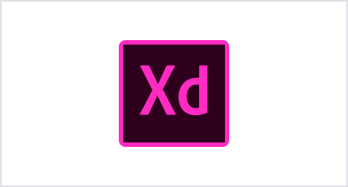















Jira Integrations
Software Engineering teams
Design teams
IT teams
Business teams
Notes:
Jira has 1000's of integrated applications in Atlassian Marktplace. Most of these integrations are free and easy to install. Slack, GitHub, Zendesk Jenkins Github Opsgenie Miro Trello Microsoft Teams Google Sheets
Design teams
IT teams
Business teams
Software Engineering teams

Slide 45


Slide 46



How well did you like this lesson?
Notes:
Temperature Check
Get a sense for how well your lesson resonated with your students, or how engaged they were.
🍐 This is a Pear Deck Draggable™ Slide.
🍐 To edit the type of question, go back to the "Ask Students a Question" in the Pear Deck sidebar.

Slide 47

THANKS!
Any questions?
You can find me at:
@Martin - Instructor
martin@clarusway.com

